Slide 1

Data Modeling
with Tableau

Slide 2
Concept
Data Modeling
80%
Data Visualization
20%

Slide 3
A single table with all the columns doesn't work
The file is unnecessarily large.
One column contains redundant data.
Calculations are slow.
The data model is underutilized.
Data inaccuracy!

Slide 4
Star schema
1. The fact table : serves as the central repository for numerical data.
2. Dimension tables : provide descriptive context and are typically numerous.

Slide 5
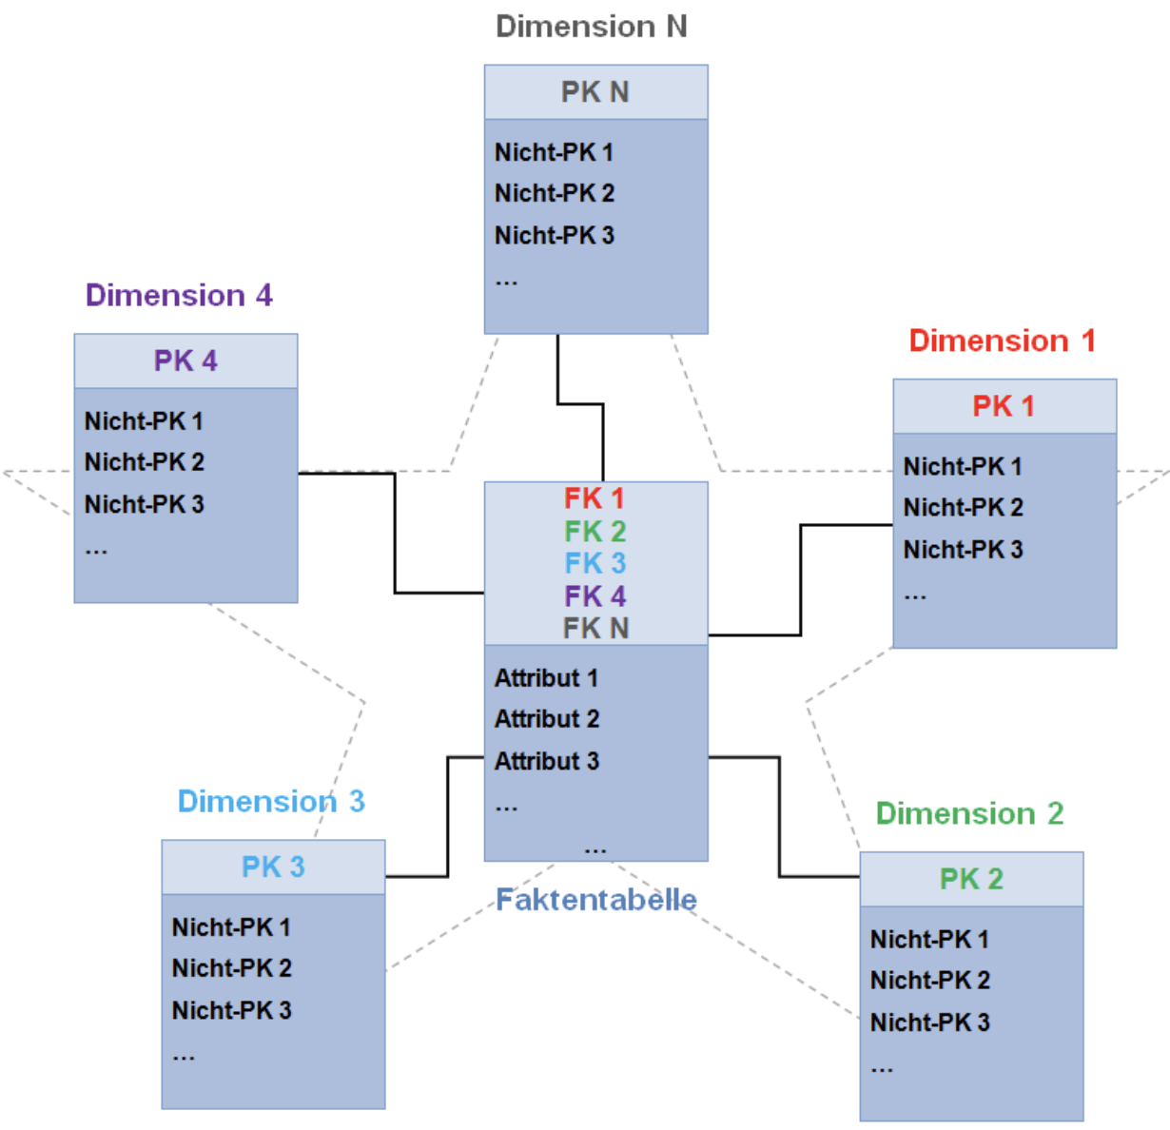
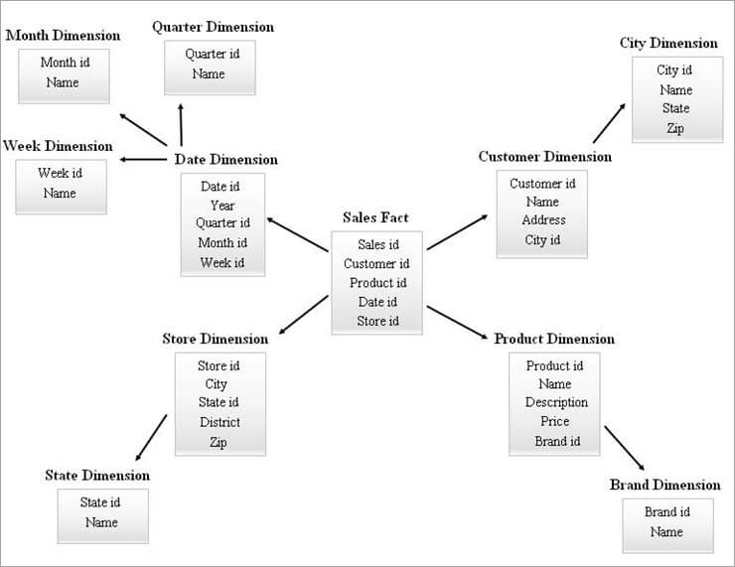
Star schema vs snowflake schema
Star Schema
More Efficient
Simple Model
Reductant data
Snowflake Schema
Remove reducdant data
More complex as needed
Relatively slower than star schema

Slide 6
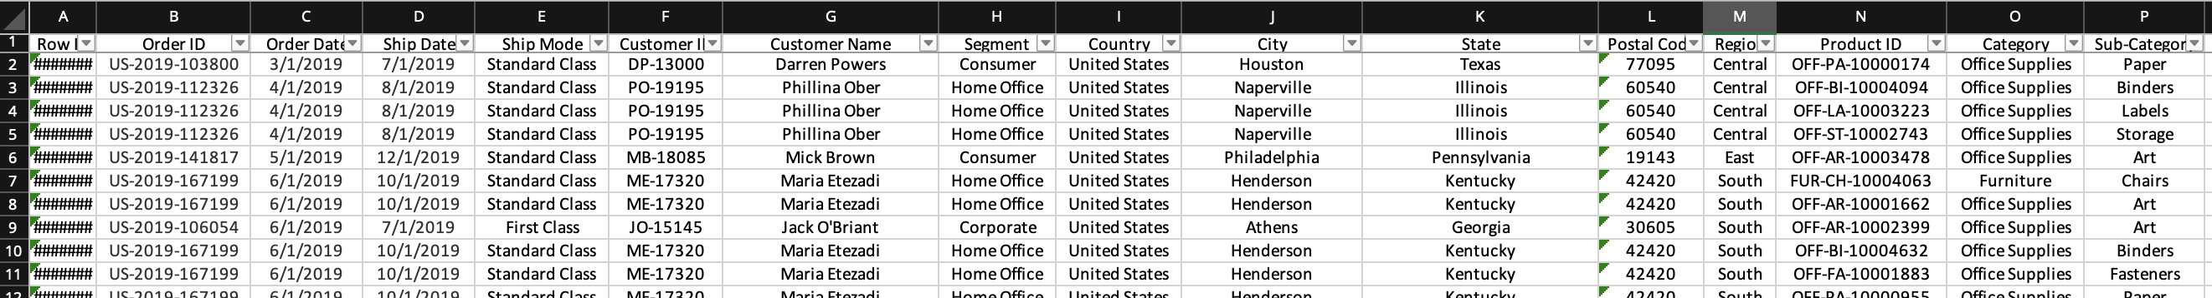
Normalization
Database normalization involves splitting tables to eliminate data redundancy. Identify columns with recurring data and create separate tables for them.

Slide 7
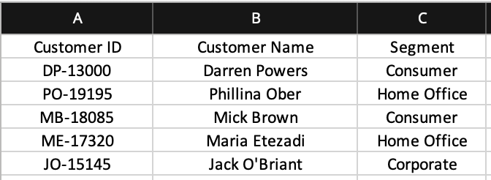
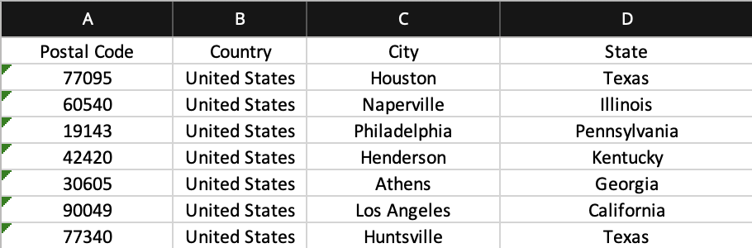
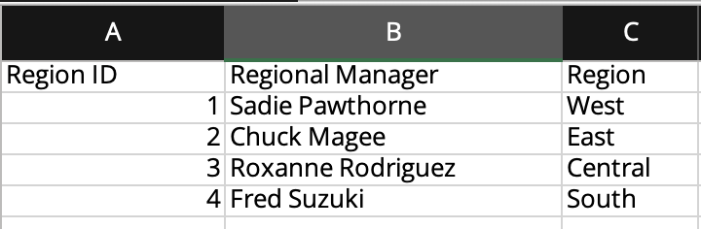
Normalization
Fact Table
Dim Table
Dim Table
Dim Table
Customer Table
AdressTable
Manager Table

Slide 8
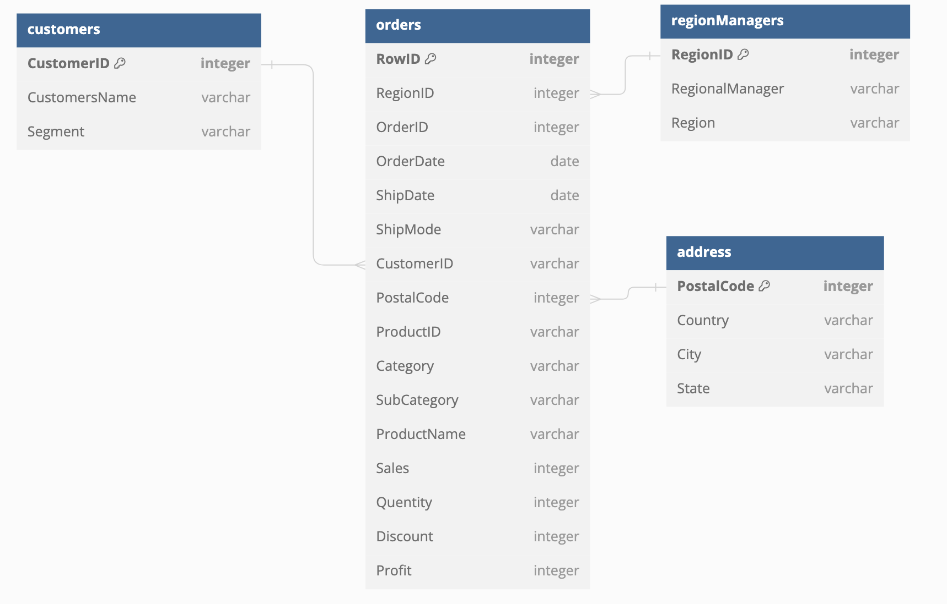
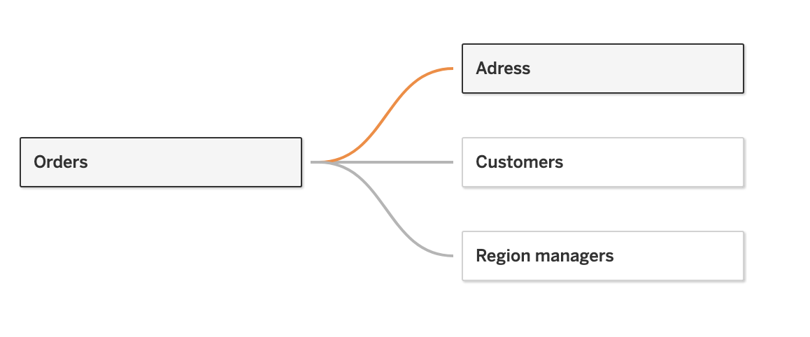
Tableau
Data Model
ER Diagram

Slide 9
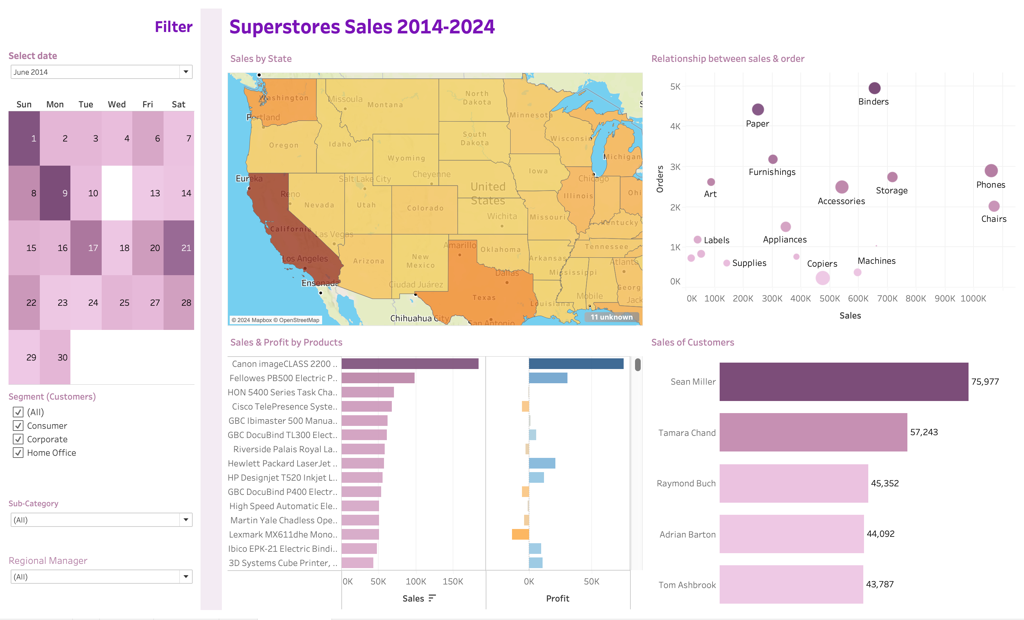
Visualization

